Slide 1
Predicting Readmissions of Diabetes Patients
Team (group 3):
Narendran R
Pratheepa Alapaka
Shekhar Prathap Singh
Mentor:
Mrs.Anjana Agrawal

Slide 2
Problem Statement
Healthcare Domain Testing is a process to test healthcare application for various factors like standards, safety, compliance, cross dependency with other entities, etc.
The purpose of healthcare domain testing is to ensure quality, reliability, performance, safety and efficiency of the Healthcare application.
The dataset is to obtain a measurement of HbA1c for patients with diabetics is a useful predictor of readmission rates which may prove valuable in the development of strategies to reduce readmission rates and costs for the care of individuals with diabetes.
Steps:
Understanding the business problem
Exploring data
Processing data

Slide 3
Dataset Info
Data Types
Categorical
Numerical
Gender
Race
Age
Admission type
Discharge disposition
Admission source
Payer code
Medical speciality
Diagnosis 1
Diagnosis 2
Diagnosis 3
Glucose serum test result
A1c test result
Change of medications
Diabetes medications
24 features for medications
Encounter_id
Patient number
weight
Time in hospital
No. of lab procedures
No. of procedures
No. of medications
No. of outpatient visits
No.of emergency visits
No. of inpatient visits
No. of diagnoses
Shape:
101766 rows
50 columns
Data Type:
Categorical = 39
Integer = 11

Slide 4
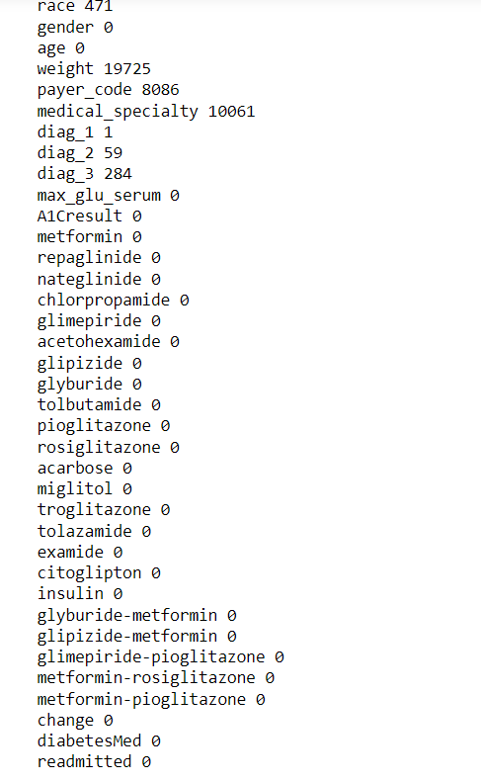
Data pre-processing
In the dataset missing values are represented as '?' sign
Dropping the insignificant columns
Evaluating and treating the null values
Encoding done for categorical features
Before null value treatment

Slide 5
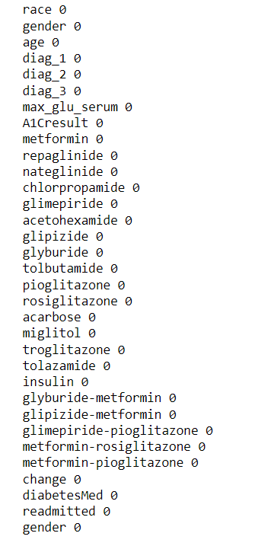
Data pre-processing
Columns after null value treatment and dropping the unwanted columns.

Slide 6
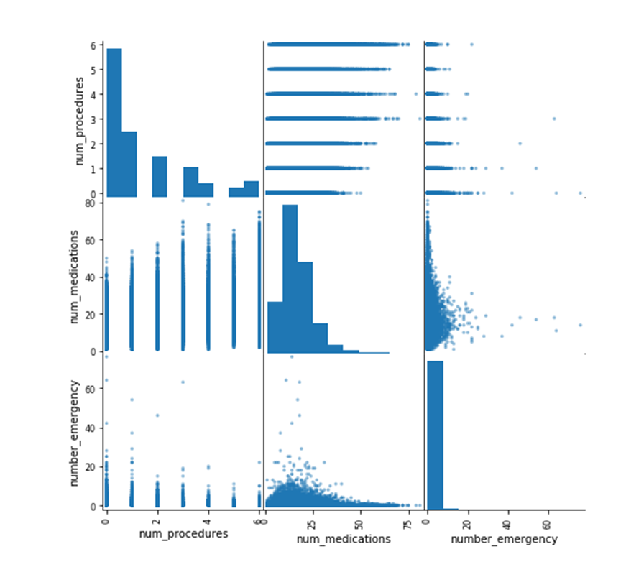
Data understanding
Performing Exploratory data analysis to get a basic sense about the data.
Since there are multiple variables,
trying to figure out the correlation
so that we can use less variables.

Slide 7
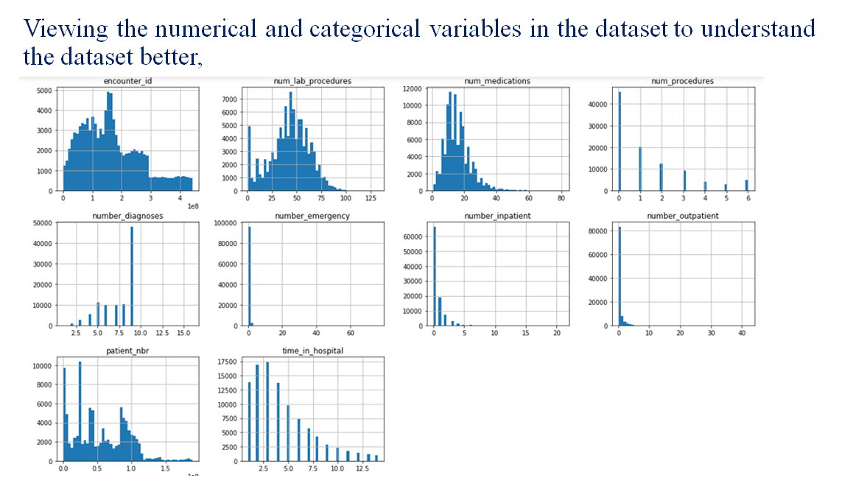
Data understanding

Slide 8
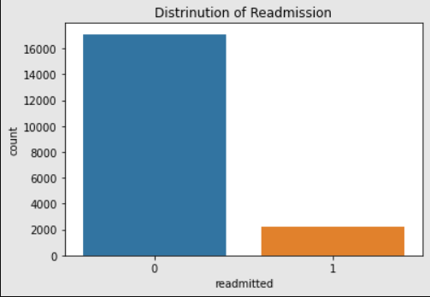
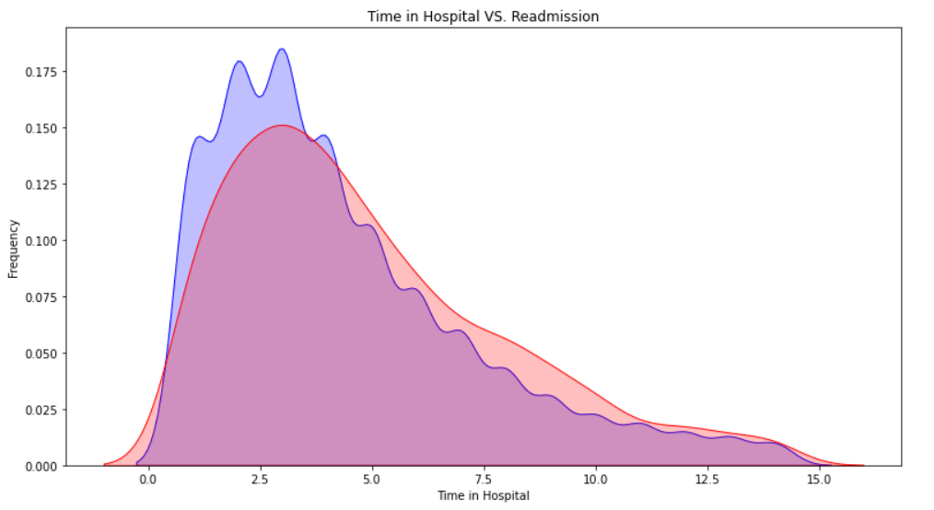
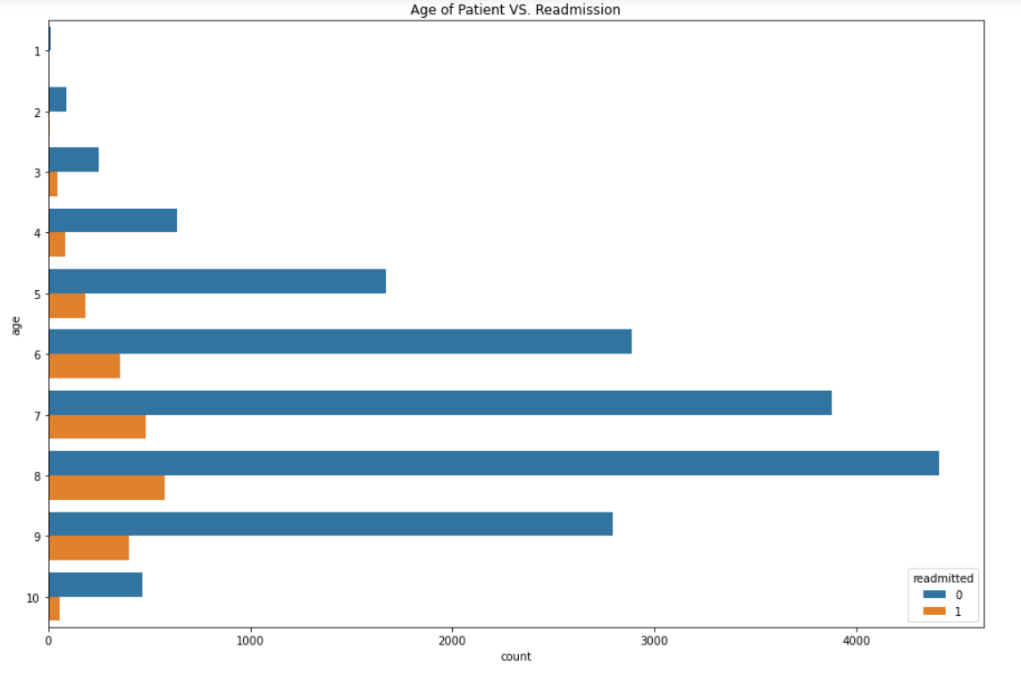
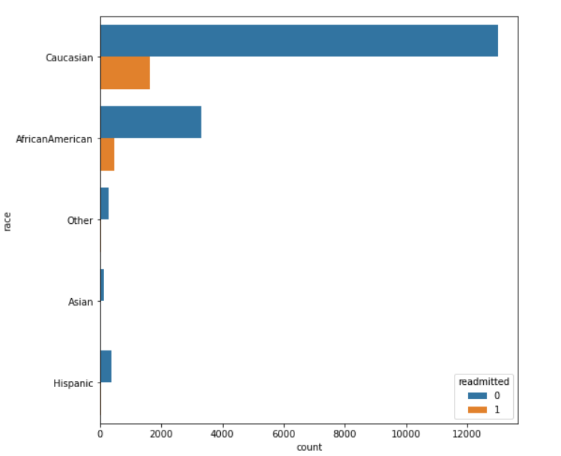
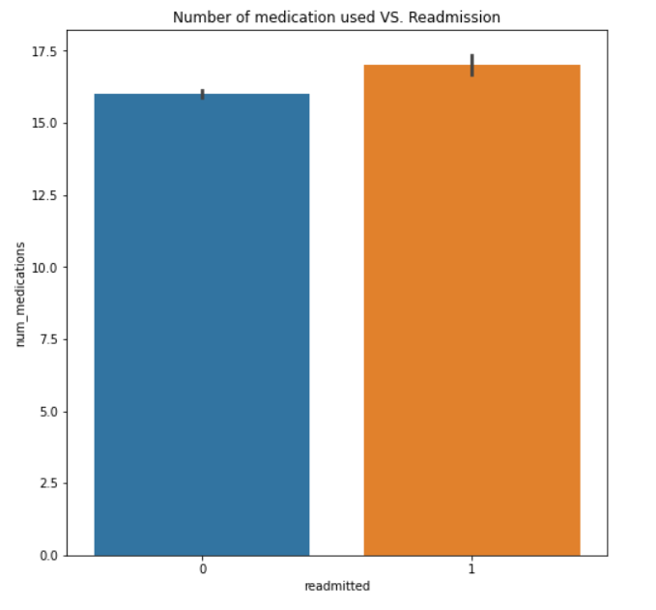
Data visualization

Slide 9
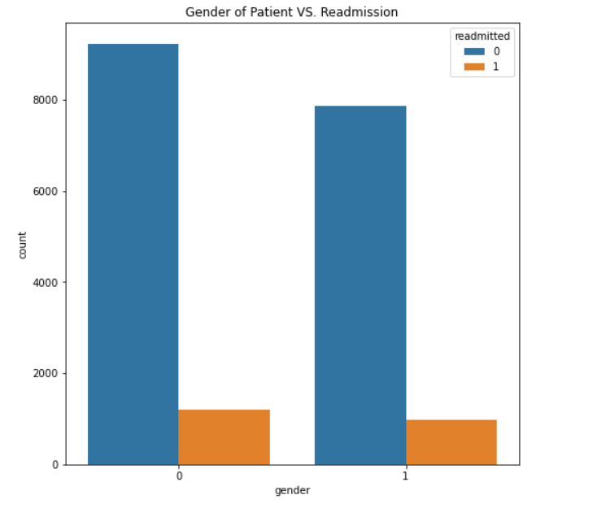
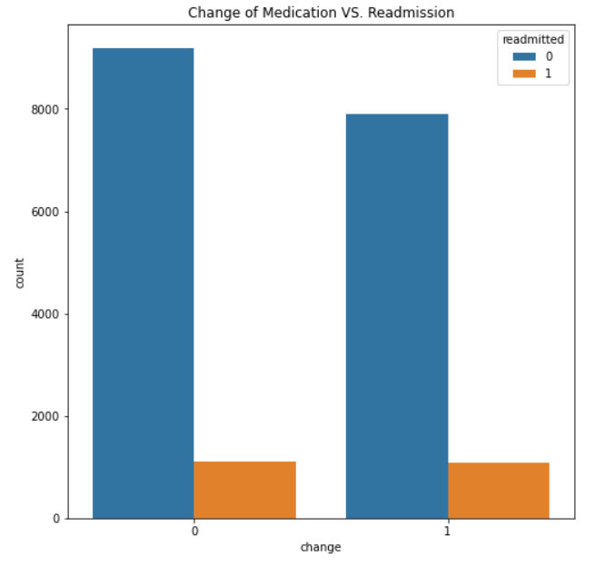
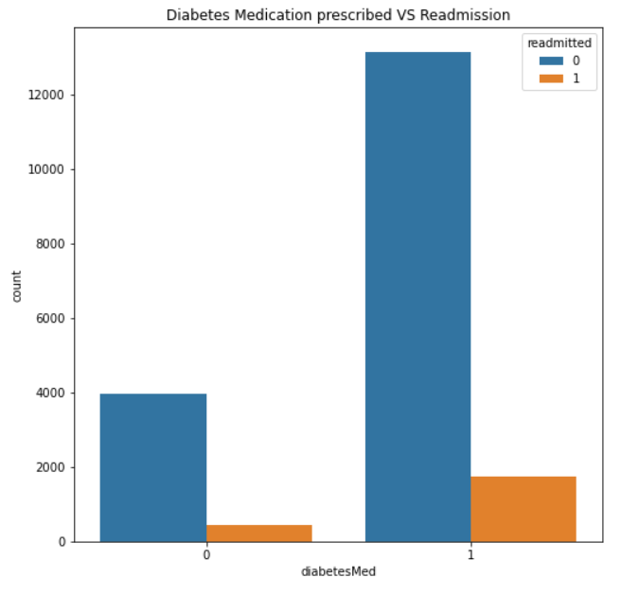
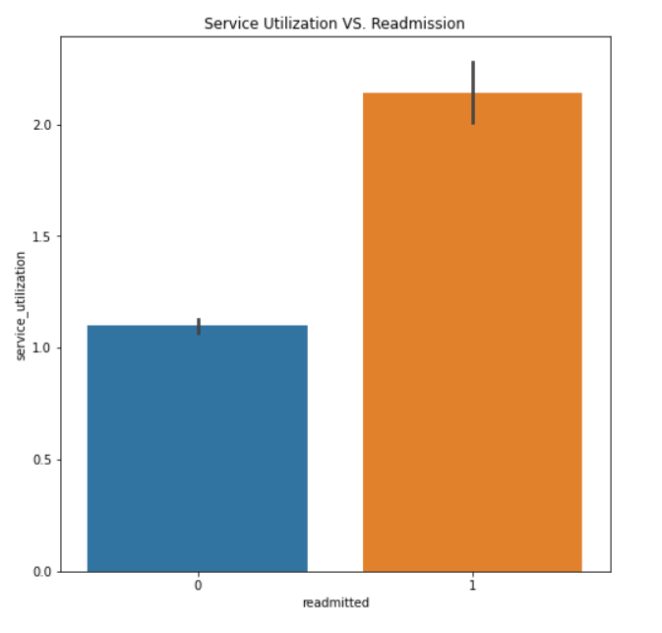
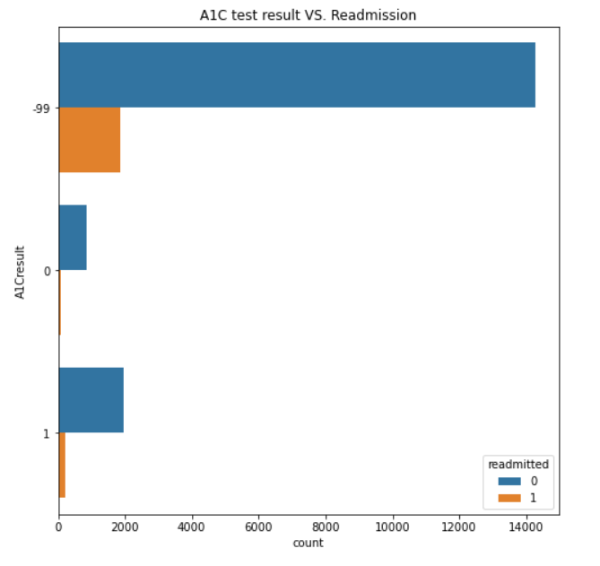
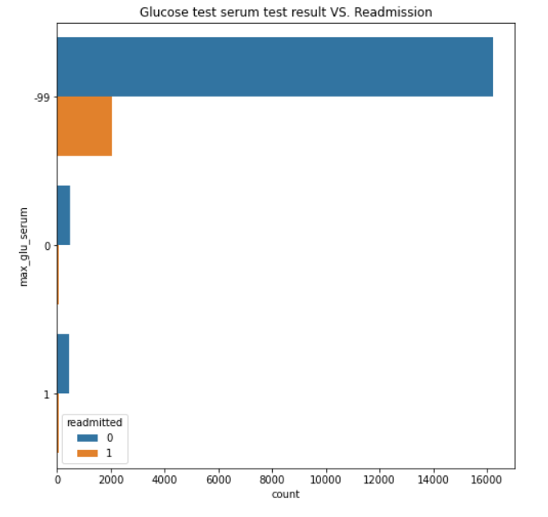
Data visualization

Slide 10
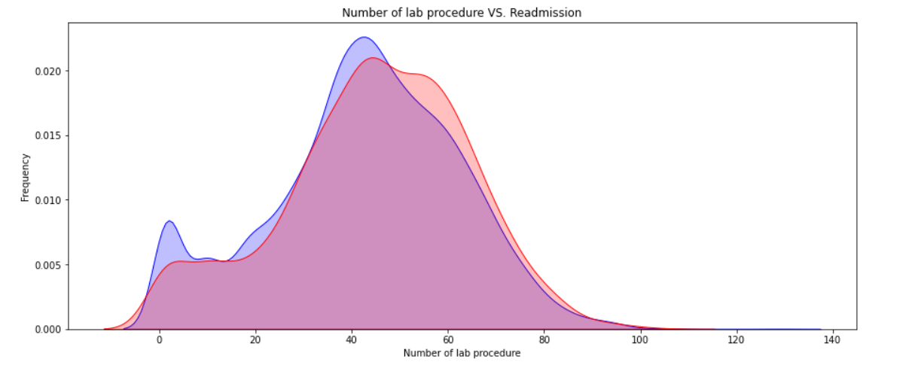
Data visualization

Slide 11
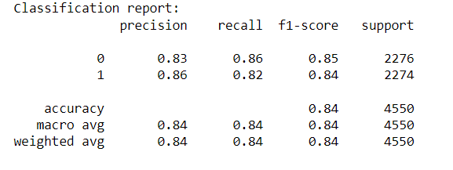
SOLUTION APPROACH - Prediction of Readmissions
Fitting the base model – Logistic Regression
Comparing with other classification models
Models | Accuracy scores | ROC AUC scores
LR | 0.84 | 0.90
RF | 0.92 | 0.96
KNN | 0.85 | 0.91
GNB | 0.63 | 0.83
XGB | 0.79 | 0.94

Slide 12
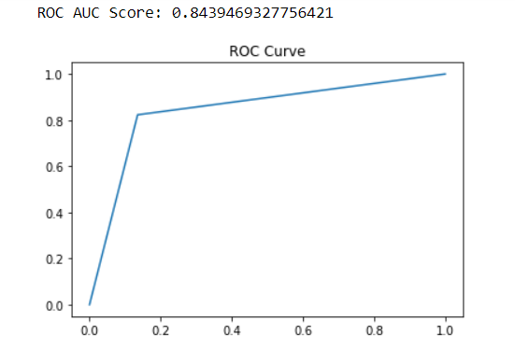
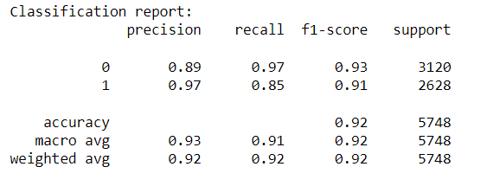
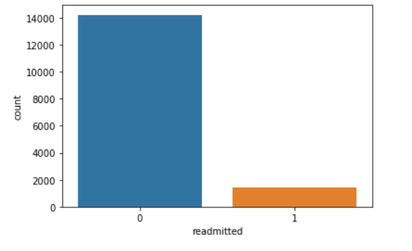
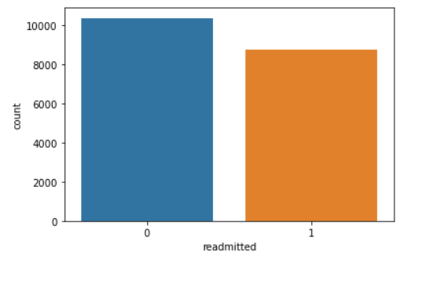
Best model – XG Boost Classifier
Treating imbalance data – SMOTE and Near Miss

Slide 13
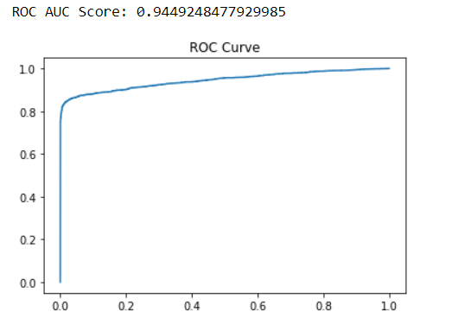
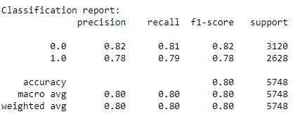
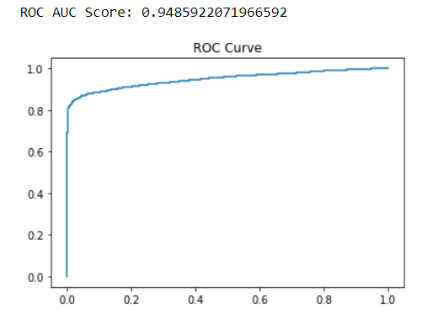
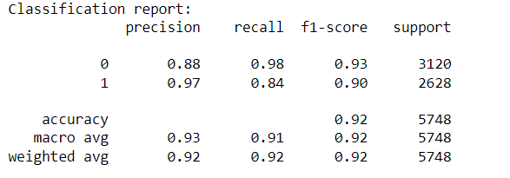
Final model – XG Boost Classifier (Balanced Data)
Tuning hyper parameters
{'gamma': 2, 'learning_rate': 0.15, 'max_depth': 6, 'n_estimators': 120}

Slide 14
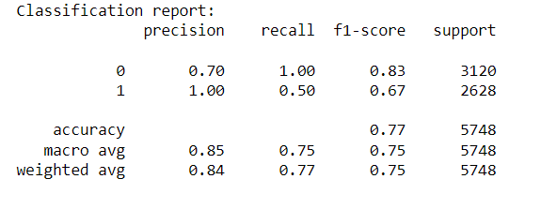
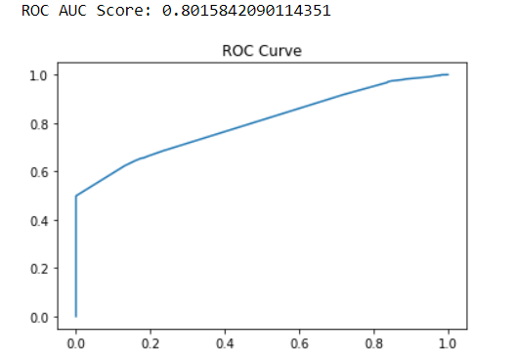
Feature selection

Slide 15

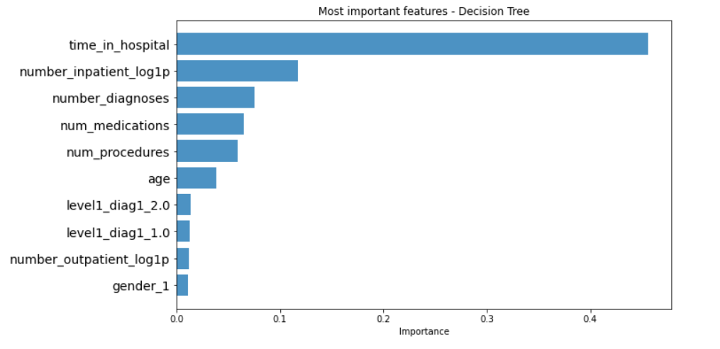
Decision Tree

Slide 16
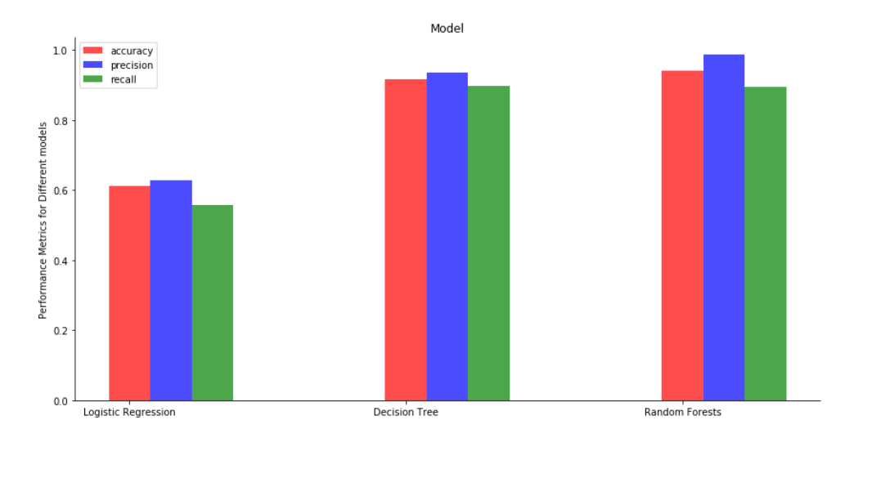
Modeling, Evaluation and Feedback
Based on the above accuracy and recall values:
Random forest seems like the best model to use.
The number of False negatives in Random forest are less and the accuracy is higher than the rest of the models.
The accuracy is about 64%.
Adaboost after tuning also gives a good accuracy but, Random forest is more easily understandable.
Hence, we should go ahead with Random forest.

Slide 17
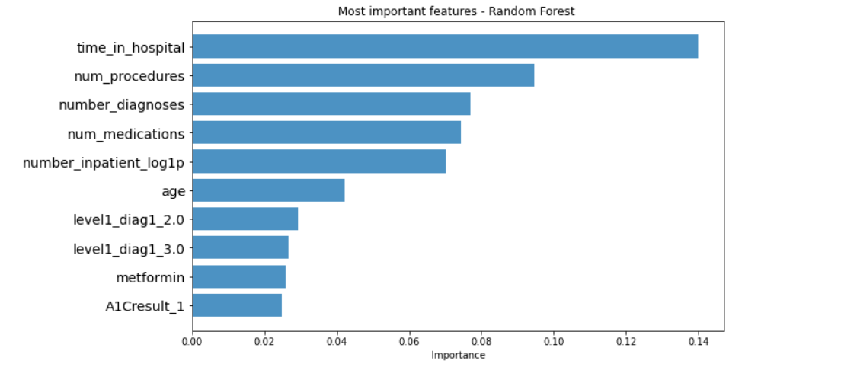

Random Forest
From deploying multiple models, we came up with Random forest.
Now we can suggest to the hospital authorities the variables which have the most effect on the readmission rate.
The diagram explains it all:-

Slide 18
Assumptions, Limitations & Further Works
The dataset includes some useful information but still lack certain aspects like access to care etc. which might impact the readmission to a huge extent.
More data preprocessing could have been performed to improve the model accuracy further. So, in future this is one area which can be explored.
Variations of different machine learning techniques can be used.

